Slide 1
INDUSTRIAL TRAINING PROJECT
AT
Pepcoding Education Private Ltd.
On The Topic Of
Web Scraper Project
(IPL Data Extraction from
website EspnCricInfo.com
using JavaScript and Node)
SUBMITTED BY: -
Name: Gursimranjit Singh Tara
Enrollment No: 06913203119
Stream: IT-2 (Department Of Information Technology)
College: Guru Tegh Bahadur Institute of Technology, New Delhi

Slide 2
ABOUT THE COMPANY
Pepcoding Education Pvt. Ltd.:
Vision:
to bring in "The Great Indian Coding Renaissance".
Pepcoding, founded in 2017 with the vision to bring in "The Great Indian Coding Renaissance". We specialise in teaching Data Structure & Algorithms ,Web Development, Data Science ,CORE, CBSE, GATE & Business Analytics and getting the best results out of these courses with more than 1000 placements in the past 2 years.

Slide 3
INTRODUCTION
Internship duration: 5 Months(24th March 2022 – 24th August 2022) (Remote)
Purpose of the project:
The purpose of the project is to scrap or extract data from EspnCricInfo.com IPL 2021 page (URL: https://www.espncricinfo.com/series/ipl-2021-1249214) and then convert this extracted data into structured format. The team names are stored as directories names and in each team directory their players information is stored in excel spreadsheet format which can be later used for multiple purposes like data analytics.
Project Specifications: -
Languages used: JavaScript
IDE used: Visual Studio Code
Node Modules Used: request, JSDOM, xlsx
Hosted on: GitHub repository
Link: “https://github.com/CODERXGursimran/ESPN-CricInfo-WebScrapper”
Status: Active and Public

Slide 4
INTRODUCTION
There are four JavaScript files driving the whole project: -
home.js:
The request module first sends the request to the ESPNCricInfo.com IPL 2021(URL: https://www.espncricinfo.com/series/ipl-2021-1249214) and as a response we get the IPL 2021 page. Then the second request is made to the CSS selector specified meaning button “view all results”. The page which is loaded acts as the input for the next script file “allMatchPage.js”.
allMatchPage.js:
This script accepts the output generated from “home.js” as an input. Then it sends a request to server requesting the scorecard of all the matches ever played during the whole season of IPL. Finally, it produces the output as all the scorecards of all the matches which acts as the input for the next script file “scorecard.js”.
scorecard.js:
This script file accepts the output generated from allMatchPage.js i.e., the scorecard, it scraps the data of all the batsman in both the tables and the helper.js file helps in structuring this unstructured data and lastly directories are created using dataOrganizer function. The dataOrgainzer function makes a directory by the name of team name and in each directory stores a file with the name of batsman who played at least one match during the whole season.
helper.js:
This file is helping to organize data into the excel spreadsheets by storing batsman name as the name of the excel spreadsheet which contains all the records of the batsman.

Slide 5
INTRODUCTION
Running the Script: -
Install VS Code IDE and NodeJS from any browser.
Open the directory in which all the files of the project are present.
Open an integrated Terminal and install the below dependencies using commands:
npm install request
npm install JSOM
npm install xlsx
After installing, type: “node ./home.js” and the script will execute.
Hosting on GitHub: -
Create a new Repository “https://github.com/CODERXGursimran/ESPN-CricInfo-WebScrapper”
Upload all the files of the project that are part of the project through button “Add file” in the repository and commit the changes for every file uploaded.
To install the project on local machine click on vertical buttons and download ZIP file. Later extract it and run the script as stated in the “running the script section”.

Slide 6
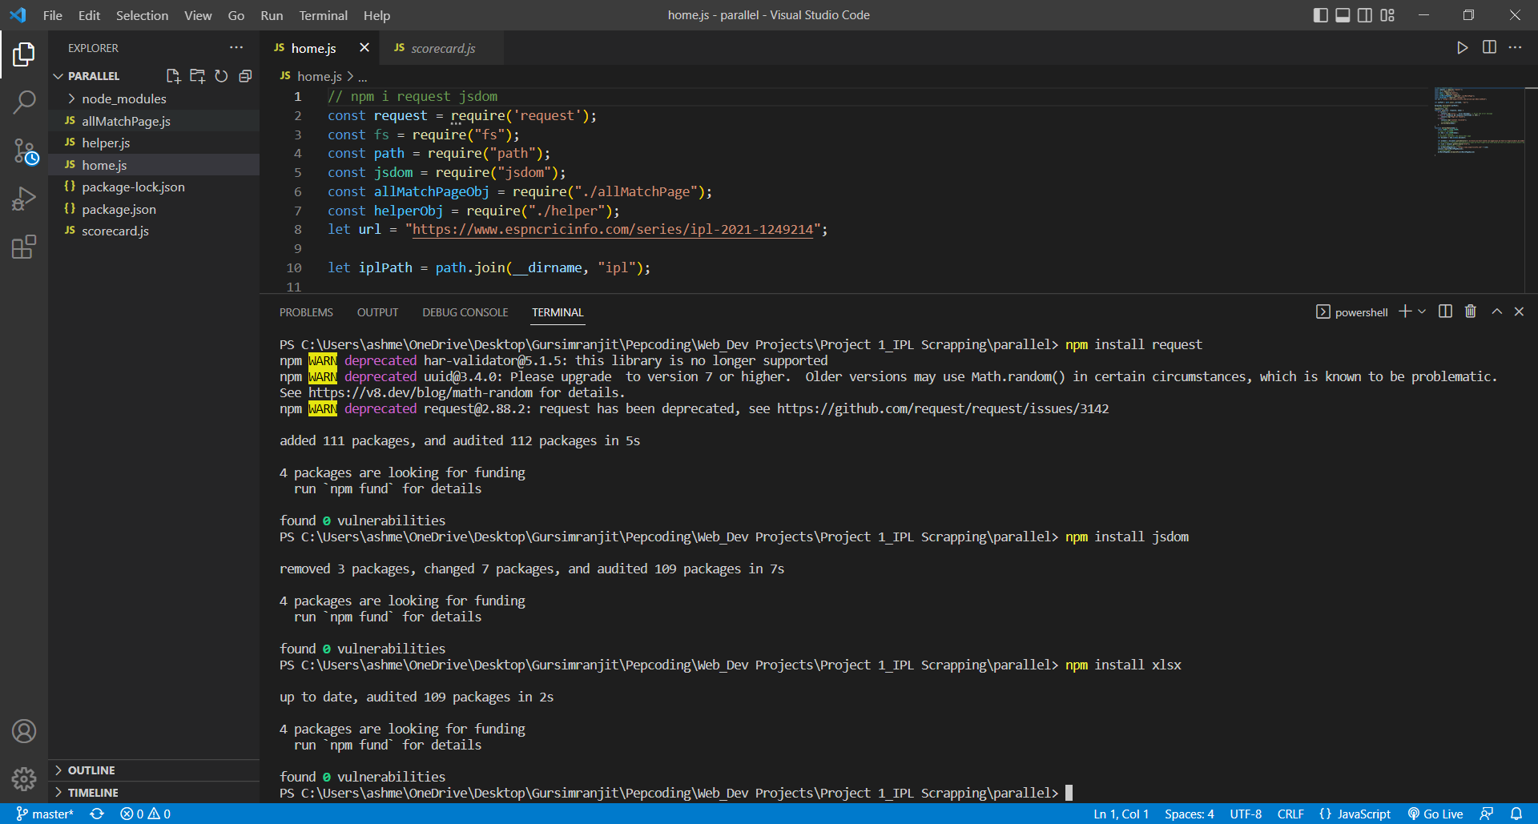
SCREENSHOTS OF PROJECT (1/4)

Slide 7
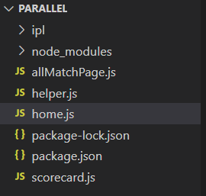
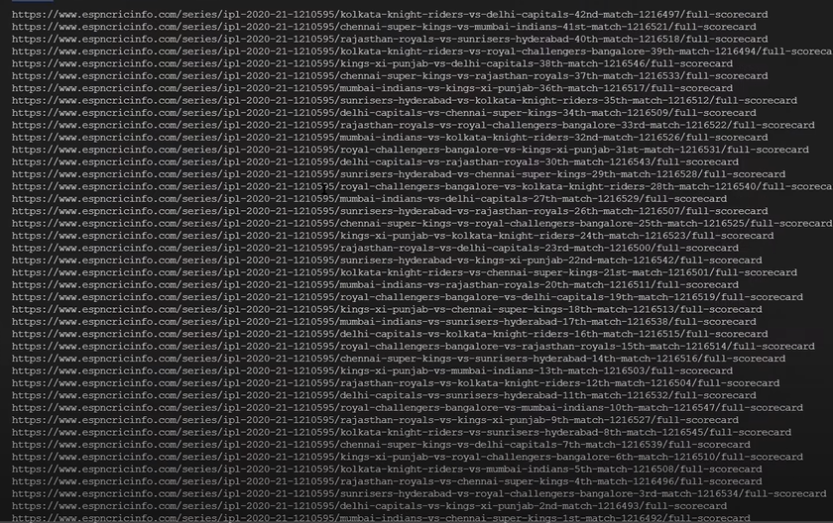
SCREENSHOTS OF PROJECT (2/4)

Slide 8
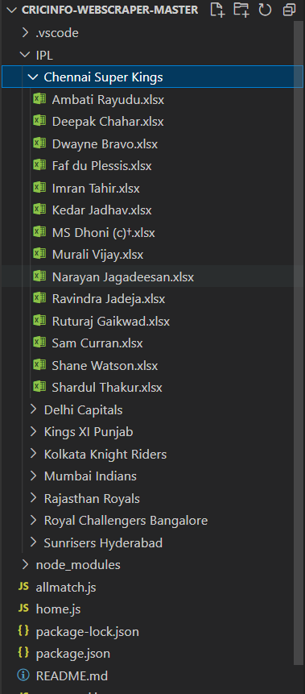
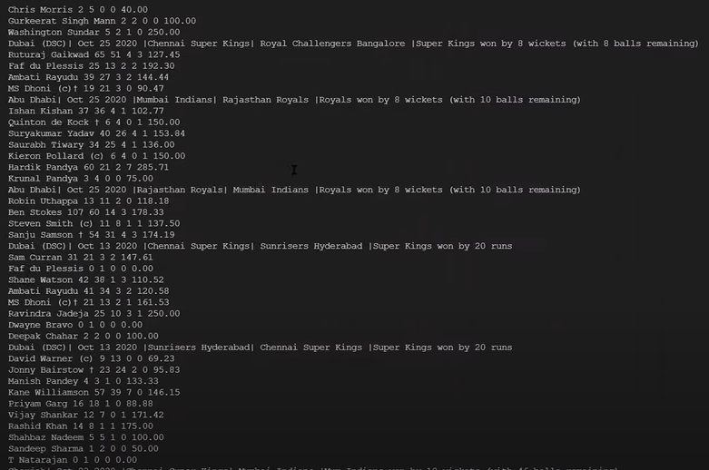
SCREENSHOTS OF PROJECT (3/4)

Slide 9
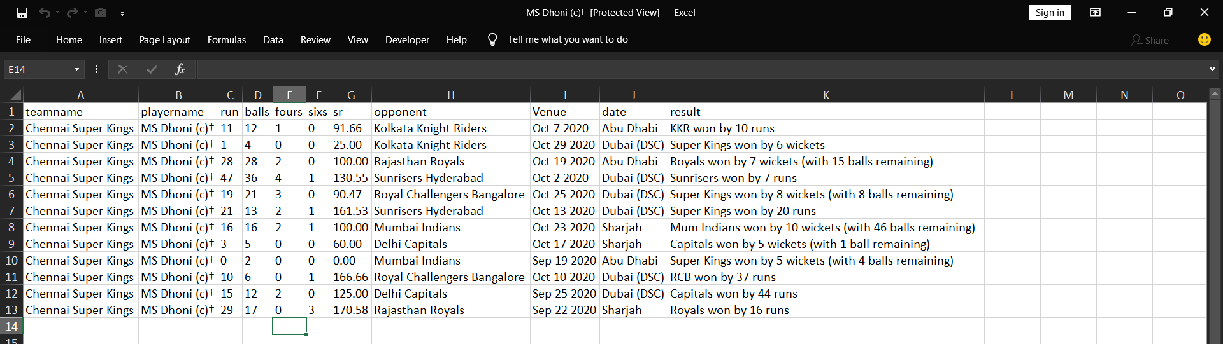
SCREENSHOTS OF PROJECT (4/4)

Slide 10
LEARNING OUTCOMES
Learned how to implement JavaScript to effectively scrap data from a website.
Became familiar with web design and got to know how to implement theory into practise.
Learned how to use node packages inside JavaScript programs.
Learned how to scrap data with the help of CSS selectors to gain access to certain elements.
Lastly, I learned how to operate in GitHub that is creating repository, uploading files, committing changes and lastly hosting the project.

Slide 11
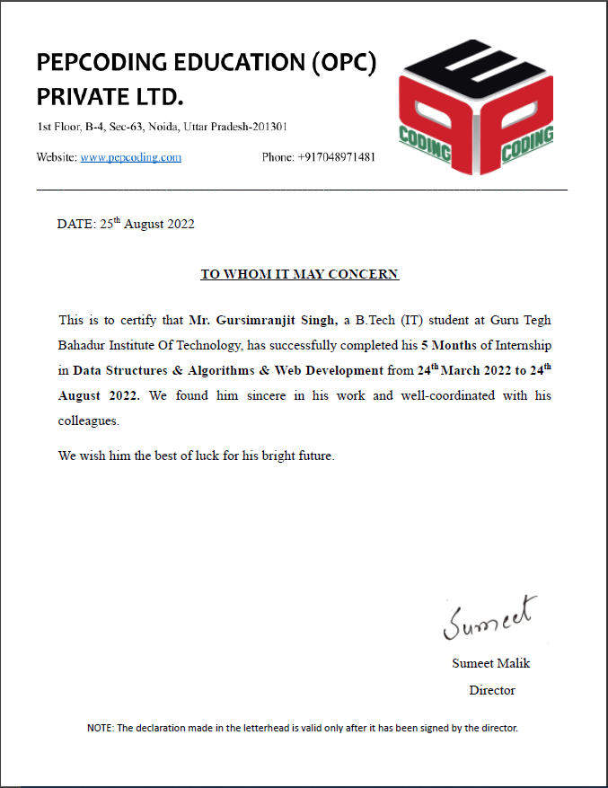
CERTIFICATE OF COMPLETION

Slide 12
REFERENCES
[1] https://www.espncricinfo.com/series/ipl-2021-1249214 page on which the first request is made by request node package.
[2] https://www.espncricinfo.com/series/ipl-2021-1249214/match-schedule-fixtures-and-results to make request for scorecards of all teams.
[3] https://www.espncricinfo.com/series/ipl-2021-1249214/mumbai-indians-vs-royal-challengers-bangalore-1st-match-1254058/full-scorecard sample to access scorecard of all teams like this one.
[4] https://www.espncricinfo.com/player/rohit-sharma-34102 sample to access all information of player.
[5] https://nodejs.org/en/ to read and download node.
[6] https://www.npmjs.com/package/request to read about request package which makes request to server to initiate scraping process.
[7] https://www.npmjs.com/package/jsdom to read about JSDOM package which extracts data from the web page.
[8] https://www.npmjs.com/package/xlsx to read about xlsx package which stores all data into excel spreadsheets in structured format.
[9] https://github.com/Accessed during the hosting phase and downloading process.
[10] https://code.visualstudio.com/docs for getting insights into some practices of visual studio code, the IDE used to create this project.
[11] https://www.comparably.com/companies/github to get mission, vision and about us statements of the company GitHub.
[12] https://www.geeksforgeeks.org/web-development/ accessed throughout the project to get help on various syntax.

Slide 13
THANK YOU

